Slide 1
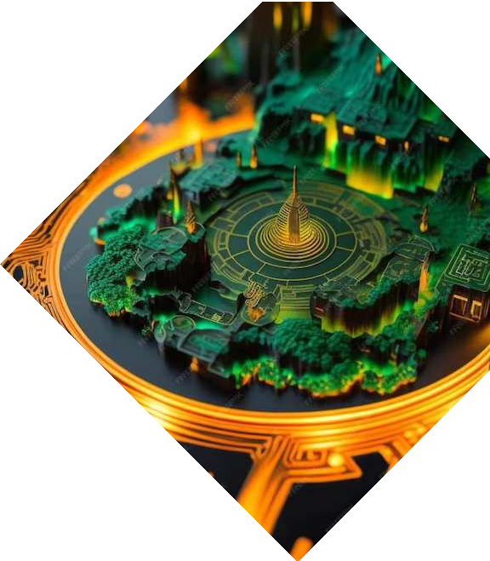

Smart Dual Axis Solar Tracker powered by Arduino Uno

Slide 2

Introduction
The importance of solar energy is increasing due to its sustainability and cost effectiveness. This presentation focuses on a Smart Dual Axis Solar Tracker powered by Arduino Uno Microcontroller for optimizing solar energy generation.

Slide 3
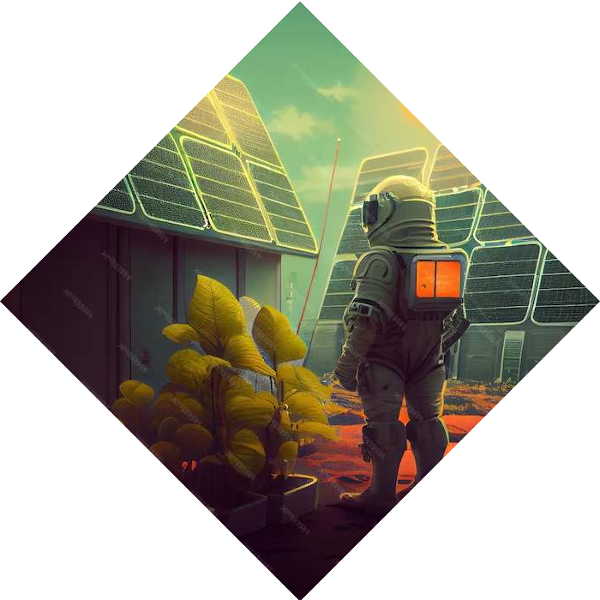
Solar Energy Overview
Solar energy is a renewable source that harnesses the power of the sun to generate electricity. The use of solar energy reduces carbon emissions and provides a sustainable energy solution for the future.

Slide 4
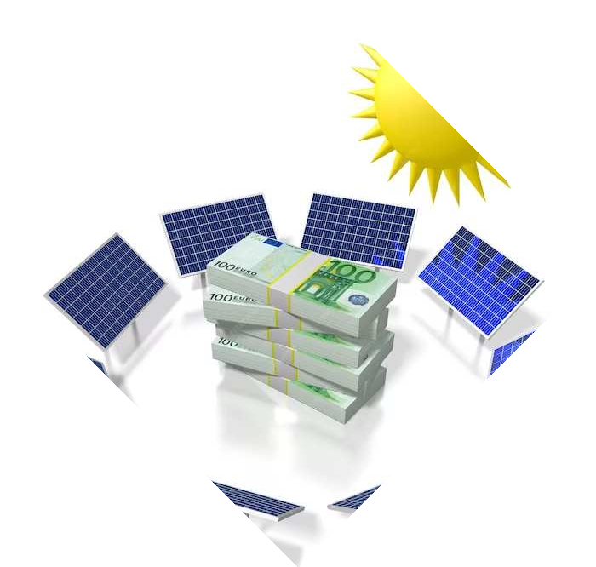
Dual Axis Solar Tracker
A dual axis solar tracker is designed to follow the sun's path in both the horizontal and vertical directions, maximizing solar energy capture throughout the day. This technology significantly improves energy output.

Slide 5
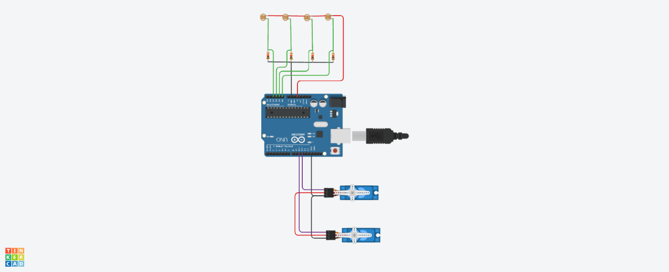
Diagram of Dual Axis Solar Tracker
10KΩ Resistors
LDR Sensor(Light
Dependent Resistors)
Arduino Uno
Servo Motor

Slide 6
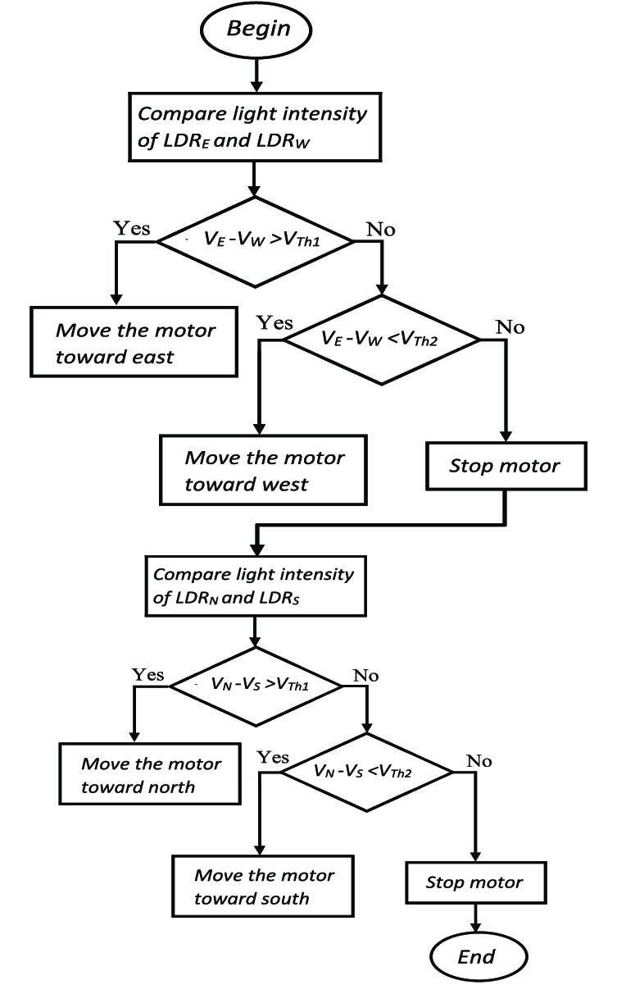

Flowchart of Dual Axis Solar Tracker

Slide 7


Pending Work
Adding of wipers
Implementing of cost effective Sensors

Slide 8
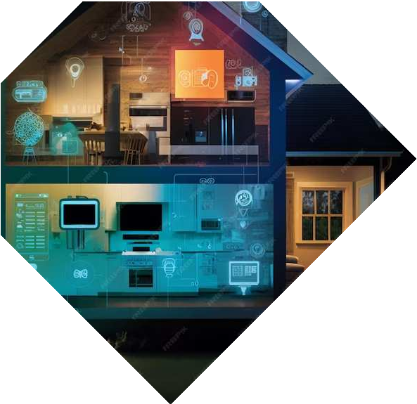
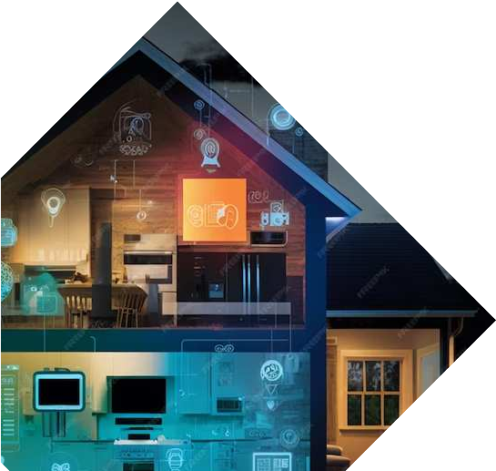
Future Developments
Continued advancements in smart solar tracking technology, coupled with the integration of IoT and data analytics, which will help in machine learning will further enhance the efficiency and performance of solar energy systems, paving the way for a sustainable future.

Slide 9
Conclusion
Energy Efficient
Cost Effective
Efficient Use of Space
Environmental Sustainability

Slide 10
Thank You

